Slide 1
Summer Internship Project

Slide 2

Data Analytics and Route Optimization
The project details the development and implementation of an AI-powered route optimization system, a core objective during my 6-week internship at Innodatatics Pvt. Ltd., Hyderabad. Our goal was to revolutionize delivery operations for Olive Mithai Shop, focusing on efficiency, cost reduction, and sustainability through cutting-edge data analytics and AI models.

Slide 3

Purpose and Importance of Route Optimization
Driving Efficiency in Last-Mile Delivery
The primary purpose of this project was to design an AI-based model that significantly enhances last-mile delivery efficiency. This system moves beyond traditional manual planning, leveraging artificial intelligence to create smarter, faster, and more reliable delivery networks.
Reduced Manual Dependency
Real-time Decision Making
Minimizes human error and time spent on route planning.
Provides instant insights for agile operational adjustments.
Sustainable Operations
AI-Driven Logistics
Lowers fuel costs and CO₂ emissions, fostering eco-friendly logistics.
Pioneers advanced AI applications within retail and logistics.

Slide 4
Client Requirements: A Data-Driven Approach
Our client, Olive Mithai Shop, required a robust, data-driven system to transform their delivery operations. The specifications demanded both precision and interactivity, setting a high bar for our AI solution.
Coordinate Integration
Realistic Route Generation
Flask Web Application
Interactive Route Maps
Ability to read and process customer and store coordinates accurately.
Deliver distance and delivery time via a user-friendly web interface.
Generate routes accounting for real-world speed limits and road conditions.
Visualize routes with interactive mapping and real-time traffic awareness.
Analytical Dashboards
Create insightful combo charts for comprehensive performance analytics.

Slide 5






Research and Development Process
Our development journey was a blend of self-directed learning, AI assistance, expert mentorship, and academic grounding. This multi-faceted approach ensured the creation of a robust and intelligent route optimization model.
YouTube Tutorials
Leveraged practical demonstrations for OpenRouteService API and dashboard design.
AI Tools (ChatGPT & Claude.AI)
Utilized for debugging complex code, optimizing algorithms, and enhancing accuracy.
Mentor Feedback
Received invaluable guidance from Innodatatics experts, ensuring alignment with real-world logistics challenges.
Academic Papers
Provided a strong theoretical foundation for delivery optimization and logistics models.

Slide 6


Software Tools and Process Flow
The project's success hinged on a carefully selected suite of modern development tools and a streamlined workflow, ensuring efficiency from input to insight.
Tools Used
Workflow: From Input to Interactive Maps
Programming: Python, Flask, Pandas, JavaScript, HTML, CSS
User Input
Visualization: Power BI, Excel
Development Environment: Visual Studio Code
Delivery details are entered into the system.
API: OpenRouteService (ORS)
Route Calculation
Multiple potential route options are rapidly computed.
Optimization
The most efficient route is automatically generated.
Display & Insights
Interactive directions and analytical insights are presented on dashboards.

Slide 7
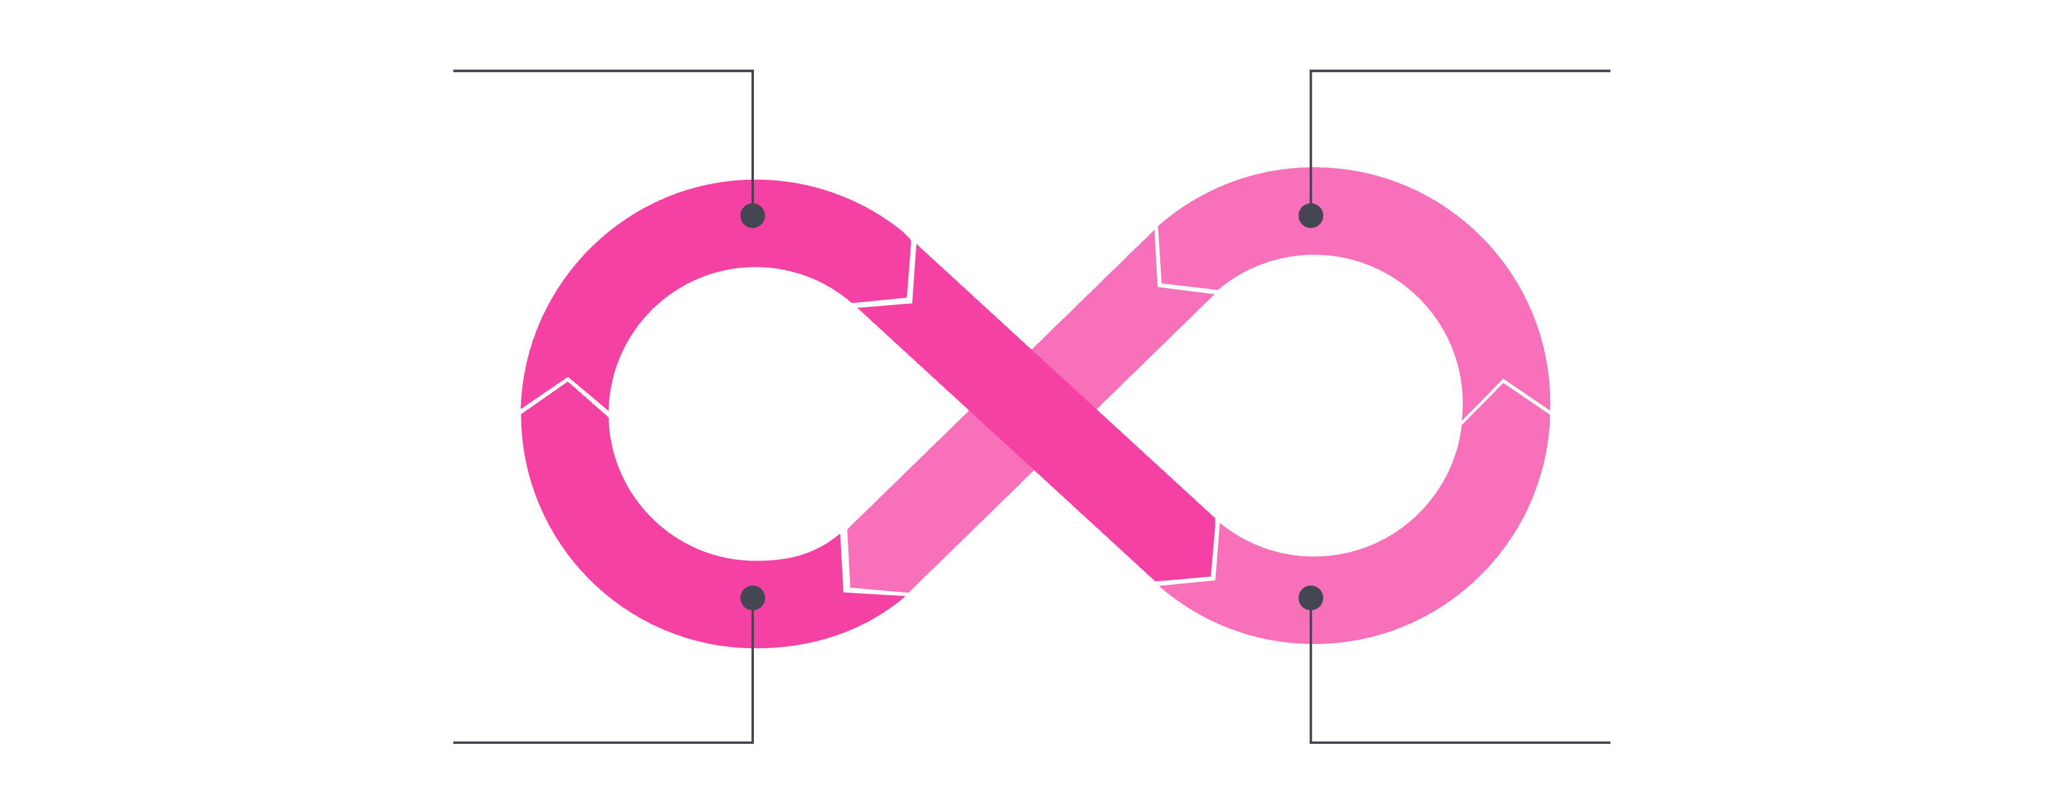
Research Methodology: CRISP-ML(Q) Framework
We adopted an Applied Research approach, coupled with Quantitative Analysis, structured around the Cross-Industry Standard Process for Machine Learning (CRISP-ML(Q)). This systematic framework guided us through every phase of development.
Data Understanding
Data Preparation
Evaluation & Deployment
Model Building
Data Understanding: Identified key challenges and gathered relevant delivery datasets.
Data Preparation: Cleaned and normalized coordinates using Python scripts.
Model Building: Developed the AI-based route engine via Flask and ORS API.
Evaluation: Compared the performance of manual routes against optimized routes.
Deployment: Launched a Flask web application for user input and live mapping.
Monitoring: Continuously evaluated results and proposed scalability enhancements.

Slide 8







Data Preparation and EDA
Thorough data preparation and exploratory data analysis were crucial for building a reliable model. We focused on cleaning, enriching, and visualizing data to uncover key patterns and insights.
Data Cleaning
Feature Engineering
Filled missing values with verified map coordinates.
Developed new variables:
Route Efficiency Score
Removed duplicates and standardized categories.
Traffic Impact Index
Fuel Estimate
Encoded traffic indicators numerically (Low, Medium, High).
Visual Insights
Most deliveries: 5–10 km range.
Average times: Swiggy – 32 mins, Zomato – 35 mins.
High traffic adds ~15 minutes to delivery times.

Slide 9


Model Optimization and Implementation
Our AI model integrated multiple advanced techniques to achieve superior route optimization. The combination of clustering, regression, and precise distance calculation, powered by the ORS API, delivered remarkable results.
Key Steps:
Tangible Outcomes:
K-Means Clustering: Divided Hyderabad into six optimized delivery zones.
Reduced delivery distance by 12–18%.
Linear Regression: Predicted delivery time based on traffic and distance (R² = 0.93).
Significantly improved route accuracy and consistency.
Haversine Formula: Ensured distance accuracy (error < 0.5 km).
Developed a Flask-based web interface with interactive map visualization and chatbot support.
ORS API Integration: Generated highly optimized driving routes.

Slide 10
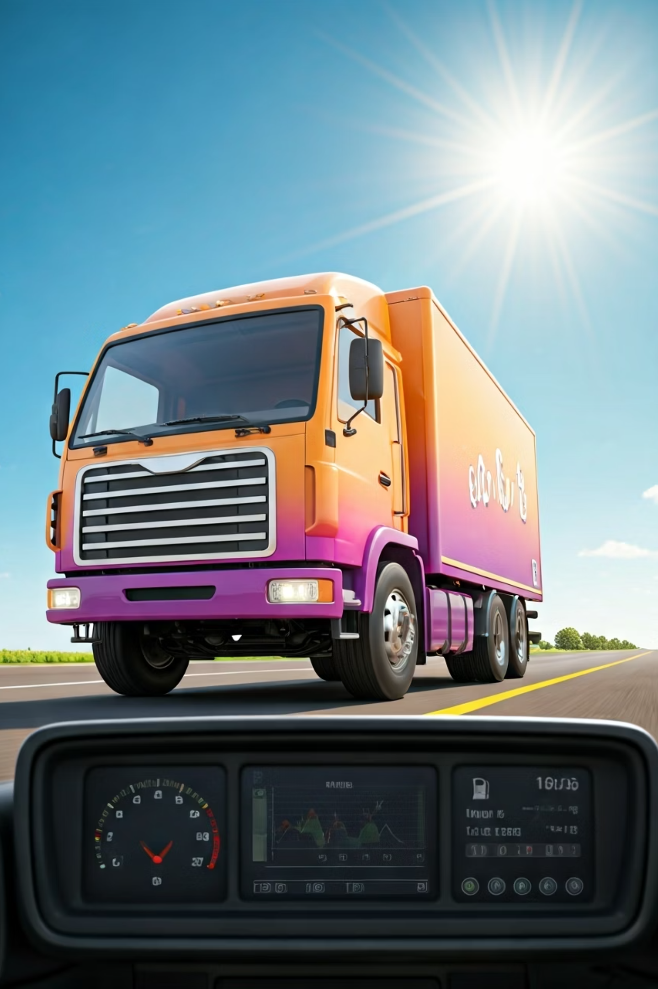
Findings and Interpretation
The implemented route optimization system yielded substantial improvements across critical operational metrics, confirming the power of AI in transforming logistics.
28-35%
20%
< 5%
Time Saved
Fuel Savings
Route Deviation
Reduction in overall travel time per delivery.
Decreased fuel consumption per delivery cycle, leading to cost reduction.
High accuracy in projected versus actual routes.
100%
Sustainability Impact
Reduced carbon emissions and environmental footprint.
These gains directly translate to increased profitability and a stronger commitment to environmental responsibility for Olive Mithai Shop. The interactive dashboards also empowered management with better control and informed decision-making.

Slide 11
Conclusion and Future Directions
This project successfully delivered a transformative AI-driven route optimization model. It not only met but exceeded expectations, showcasing the immense potential of integrating data analytics, visualization, and AI in logistics.
Key Achievements:
Up to 35% faster deliveries and 20% cost savings.
Demonstrated the power of AI for small and medium businesses.
Hands-on experience with Flask, APIs, and dashboard design.
Recommendations for Future Scope:
Real-time Traffic Integration
Driver Mobile Application
For dynamic route adjustments.
For navigation and tracking.
Predictive Analytics
Cloud Migration
For seasonal demand forecasting.
For enhanced scalability and resilience.

